Slide 1
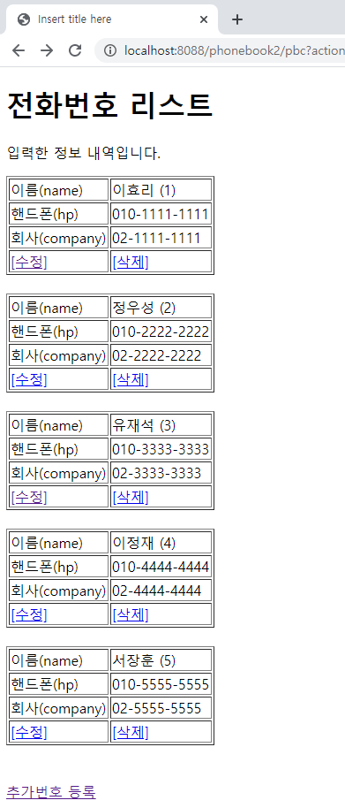
phonebook2 기능추가
01
Rqeust(요청)
삭제
Request header
파라미터: action=delete
id=1
Request body
http://localhost:8088/phonebook2/pbc?action=delete&id=1
Tomcat
phonebook2
contoller(servlet)객체
phoneDao 객체
delete일때
personDelete
(01)
getPersonDelete()
request
response
*포워드
list.jsp
객체
Response(응답)
Response header
Response body
(html)
DB

Slide 2
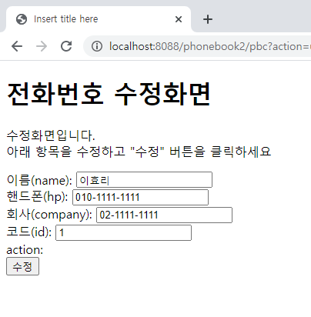
phonebook2 기능추가
01
Rqeust(요청)
수정 폼
Request header
파라미터: action=uform,
id=1
Request body
http://localhost:8088/phonebook2/pbc?action=uform&id=1
Tomcat
phonebook2
contoller(servlet)객체
phoneDao 객체
uform일때
Person(01)
getPerson()
request
response
*포워드
updateForm.jsp
객체
Response(응답)
Response header
Response body
(html)
어트리뷰트: personVo
DB

Slide 3
phonebook2 기능추가
01
수정
http://localhost:8088/phonebook2/pbc?action=update&name=이효리&hp=010-0000-0000&company=02-0000-0000&id=1
Rqeust(요청)
Request header
파라미터 action=update / name=이효리 / hp=010-0000-0000 / company=02-0000-0000 / / id=1
Request body
Tomcat
phonebook2
Contoller(servlet)객체
request
update
일때
phoneDao 객체
personUpdate()
response
리스트 요청
Response(응답)
Response header
Response body
(리다이렉트코드)
response.sendRedirect("/phonebook2/pbc?action=list");
DB
http://localhost:8088/phonebook2/pbc?action=list

